Slide 1
Transform a REST payload to SOAP
APIM
Notes:
Instructions from Expose a web service as a REST API | Axway Documentation

Slide 2
Learning Objectives
At the end of this course, you will be able to
Create a request policy using policy studio
Transform the payload of a received request (REST --> SOAP)
Enrich an API by adding an HTTP header​ to the incoming request
You will learn how to:
Expose a web service as a REST API
Virtualize a SOAP web service
Define a REST API
Route REST requests through the virtualized SOAP service
Notes:
The page is the script.

Slide 3
Prerequisites
Transform a REST payload to SOAP

Slide 4
Before You Begin
Be familiar with these concepts:
Helpful Links
API basics (change to Axway Docs, not GitHub)

Slide 5
Tutorial
Transform a REST payload to SOAP

Slide 6
Expose a web service as a REST API
Import a WSDL file and define a REST API in Policy Studio to expose a web service as a REST API.
You can import a WSDL file into Policy Studio, and invoke it from a policy instead of exposing it to a client.
For example, in a SOAP to REST use case, the web service is registered in Policy Studio by importing a WSDL file into the web service repository. A REST API is then defined in Policy Studio, which calls a policy to implement the API, and in turn, this policy invokes the web service

Slide 7
Virtualize a SOAP web service

Slide 8
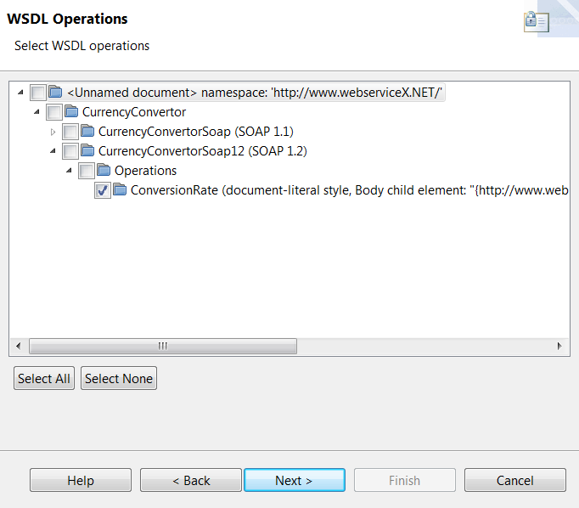
Virtualize a SOAP web service
This is an example for demonstration purposes only. Adapt the following steps to suit your web service:
To expose a virtualized version of a SOAP web service on API Gateway, import a WSDL file describing the web service into the web service repository.

Slide 9
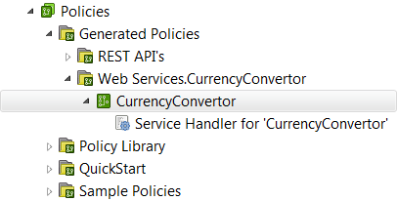
Virtualize a SOAP web service
For more information on using the Import WSDL wizard, see Import a WSDL file.
When you register a web service in Policy Studio, service handlers and policies are autogenerated.
The following figure shows the generated policies for the currency conversion service:

Slide 10
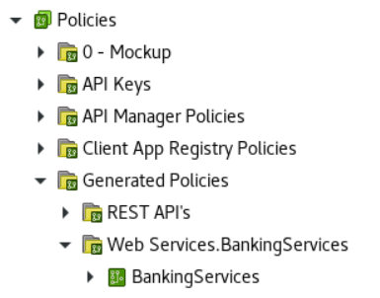
Define a REST API
The next step is to define a REST API for a stock quote service as follows:
Create a new policy container called BankingServices.
Within this policy container create a new policy called RestToSoapBankingService.
Add a Policy Shortcut filter to the RestToSoapBankingService policy, and set it to call the Banking policy that was autogenerated when you imported the WSDL for the web service. To do this, drag and drop “BankingServices” into the canvas. Right click to set it as start.

Slide 11
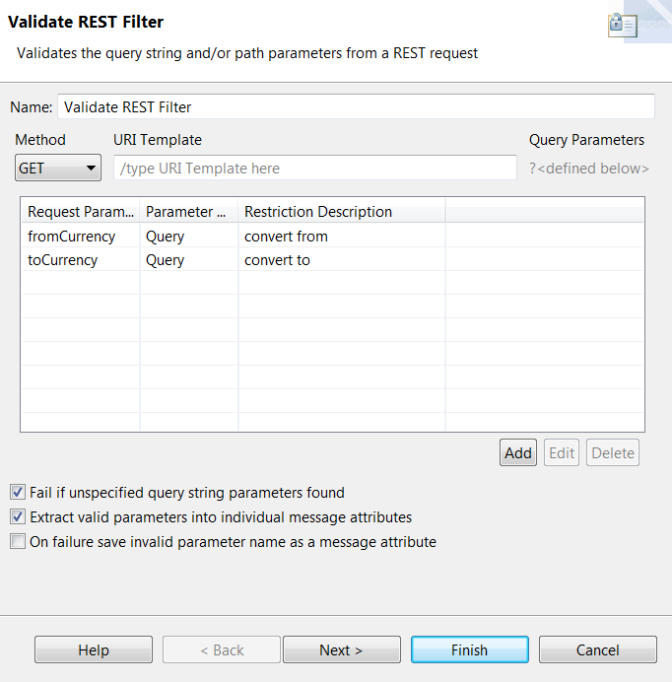
Define a REST API
Add a Validate REST filter to the RestToSoapBankingService policy. Set the Method to GET, add two request parameters called fromCurrency and toCurrency, and select the Extract valid parameters into individual message attributes check

Slide 12
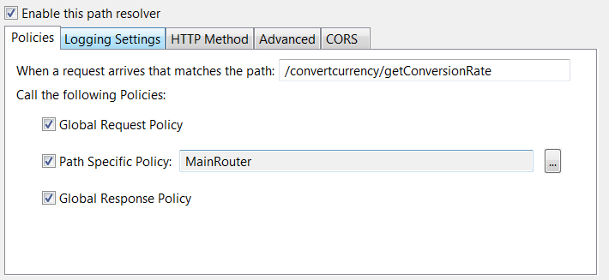
Define a REST API
Add a relative path for the MainRouter policy so that all REST requests received by API Gateway on the path /restBankingServices are processed by the RestToSoapBankingService policy. On the HTTP Method tab of the path resolver, set the method to GET.

Slide 13
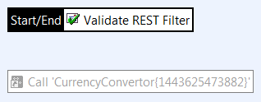
Define a REST API
At this stage, the MainRouter policy should look like this:

Slide 14
Route REST requests through the virtualized SOAP service
First, create a dedicated request processing policy to create the SOAP request message body to send to the SOAP service:
Create a request processing policy called GetSoapRequest.
Add a Set HTTP verb filter to the policy and enter POST in the HTTP Verb field. Right click and set it as start.

Slide 15
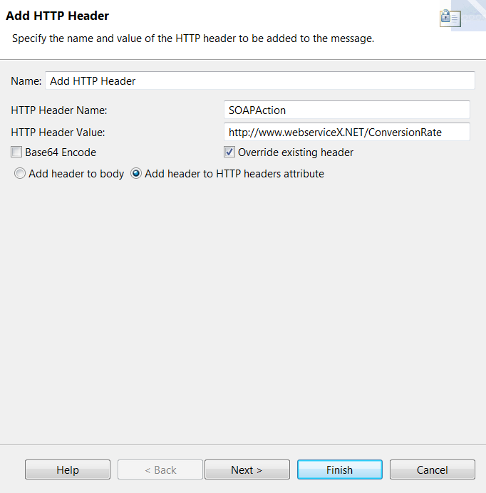
Route REST requests through the virtualized SOAP service
Add an Add HTTP header filter to the policy with the following settings:

Slide 16
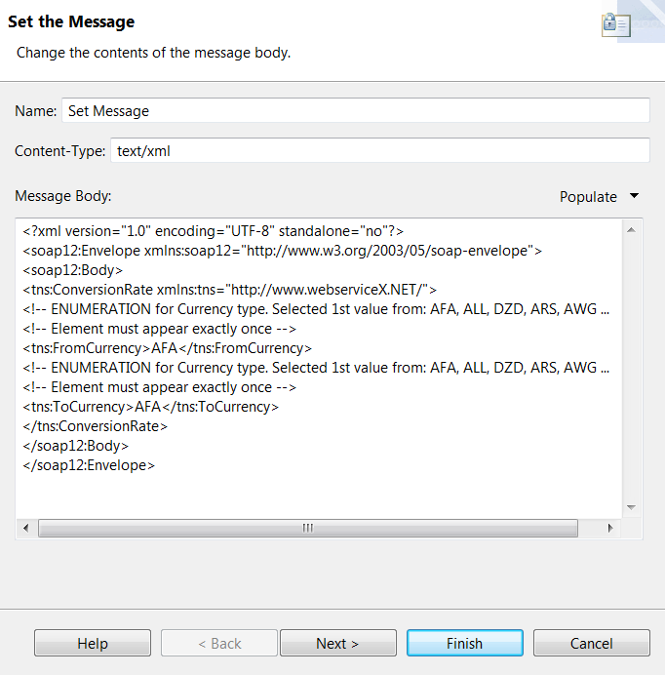
Route REST requests through the virtualized SOAP service
Add a Set Message filter to the policy and enter text/xml as the Content-Type.
Select From web service operation from the Populate menu and select the ConversionRate operation from the currency conversion web service. This populates the contents of the message body.

Slide 17
Route REST requests through the virtualized SOAP service
You need to replace the currencies in the message body with the currencies from the incoming REST request.
To enable the autocompletion mechanism in the Set Message filter, which will allow you to insert the fromCurrency and toCurrency selector strings in the message body, you must first connect up the filters in the MainRouter and GetCurrencyConvertorRequest policies.
Add a Policy Shortcut filter to the MainRouter policy, and set it to call the GetCurrencyConvertorRequest policy.

Slide 18
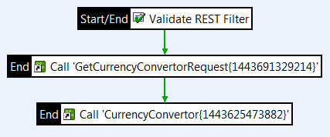
Route REST requests through the virtualized SOAP service
Connect the filters in the MainRouter policy as follows:

Slide 19
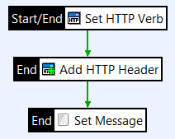
Route REST requests through the virtualized SOAP service
Connect the filters in the GetCurrencyConvertorRequest policy as follows:

Slide 20
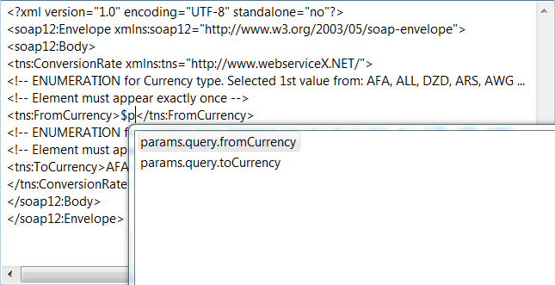
Route REST requests through the virtualized SOAP service
Edit the Set Message filter. Select the currency type in the message body and start typing to see matching selectors.

Slide 21
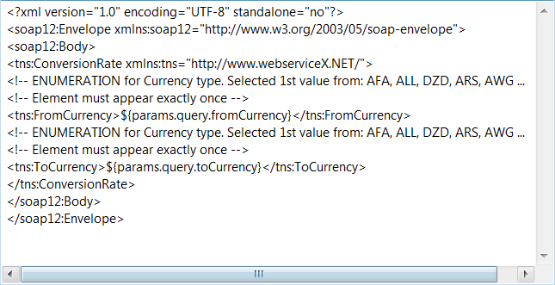
Route REST requests through the virtualized SOAP service
Insert the selectors $params.query.fromCurrency and $params.query.toCurrency in place of the currency types.

Slide 22
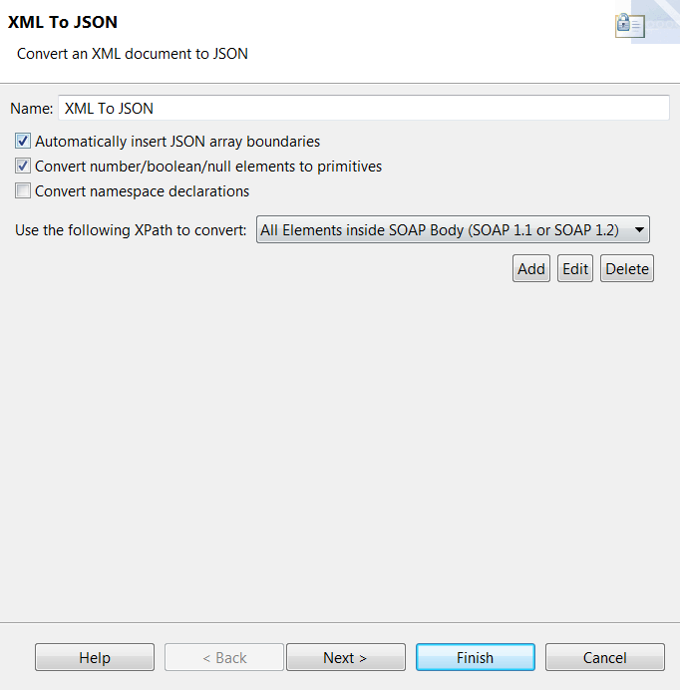
Route REST requests through the virtualized SOAP service
Next, create a response processing policy to convert the XML returned from the SOAP web service to JSON format:
Create a response processing policy called GetCurrencyConvertorResponse.
Add an XML to JSON filter to the policy. Configure it to extract the SOAP Body content first and remove any namespaces

Slide 23
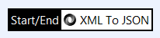
Route REST requests through the virtualized SOAP service
The GetCurrencyConvertorResponse policy should now look like this:

Slide 24
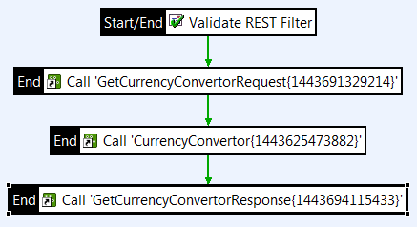
Route REST requests through the virtualized SOAP service
Add another Policy Shortcut filter to the MainRouter policy, and set it to call the GetCurrencyConvertorResponse policy.
At this stage, the MainRouter policy should look like this:

Slide 25
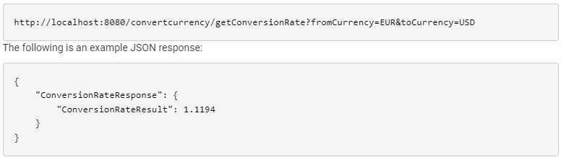
Test the REST to SOAP mapping
To test the REST to SOAP mapping, deploy the configuration on the API Gateway and send a REST request from a REST client. For example, to get the conversion rate for EUR to USD, send a request to the URL:

Slide 26
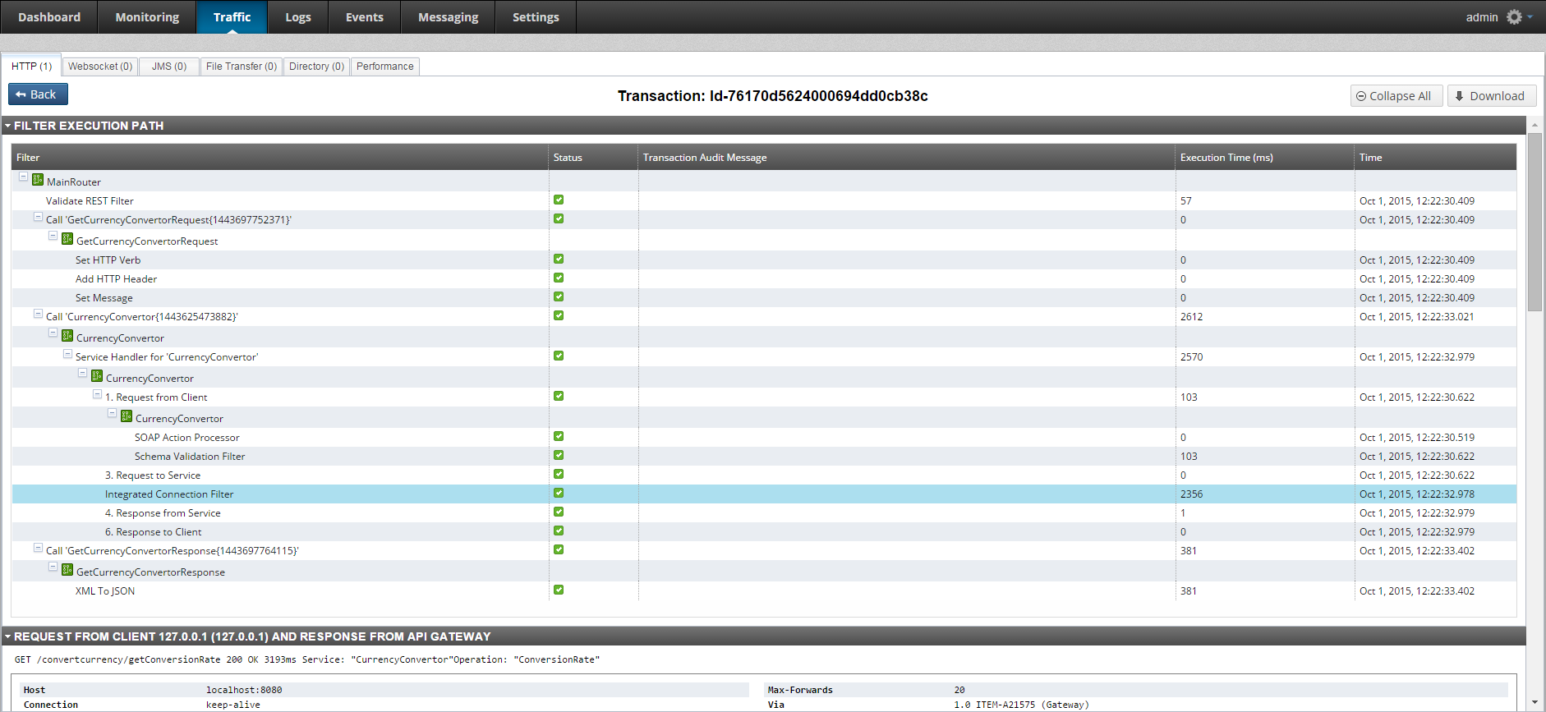
Test the REST to SOAP mapping
You can use API Gateway Manager to view the filter execution path for the REST request, and to examine the request from the client and the response from API Gateway, and the request from API Gateway and the response from the web service.

Slide 27
Recap & Next Steps (if necessary)

Slide 28
Summary

Slide 29
Recap and Take Aways
Notes:
For more information, follow the links on the screen. When you are done, click next for your quiz results and to complete this course.

Slide 30
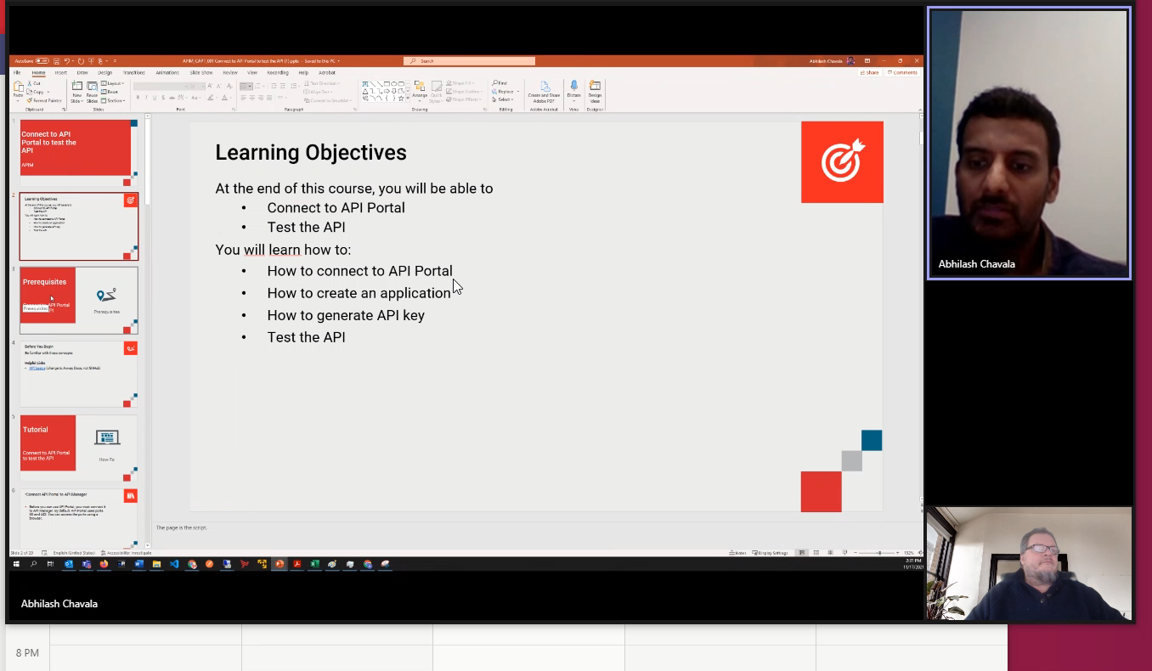
Thank you and quiz results

